Slide 1
Ford SUMURR Mobility Health project
– Phase 3 work

Slide 2



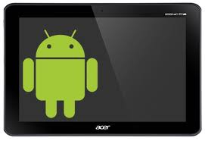

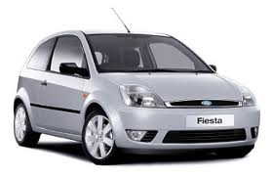
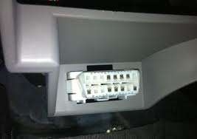





SUMURR mHealth: MOTECH based solution overview
Update/Add Patient details
MoTech Core Platform
Motech Database
OpenXCDataInterface module uses the MOTECH database to create its tables and upload and fetch vehicle data.
An integration of Vehicle Data & patient/health worker data – Contribution to Open Source
Android device uploads relevant vehicle data through OpenXCDataInterface Module
OpenXCDataInterface Module
mHealthDataInterface Module
J2ME or Android phone
Web services
DAO Layer
Web services
DAO Layer
OpenMRS DB
Exposed Web Services by OpenXCDataInterface Module can be consumed by any application
Exposed Web Services by mHealthDataInterface Module – can be consumed by any application
Patient and Health worker related DB.
so mHealthDataInterface module accesses OpenMRS database for fetching records.
In the OBD2 port
OpenXC interface
Custom Application – Consumes Web services Exposed by OpenXCDataInterface and mHealthDataInterface
Can be any J2ME , Android, iOS or a Web Portal platform
Develops an Application using the web service interface of OpenXC and MOTECH
Framework created to enable contribution from open source community
Legend:
Blue components: fully developed by HCL
Light blue components: partly developed by HCL
Developer

Slide 3
Phase 3 – Core Objective
“Develop a mobile application based on Android platform, which will talk to back-end services of the two modules that are developed by us (OpenXCDataInterface Module and mHealthDataInterface Module) as being part of MOTECH framework.
And demonstrate certain functional feature set or use cases for mobility health scenario. “

Slide 4

Phase 3 – Development Environment
UBUNTU MACHINE in HCL Dev environment
Android Tab and Ubuntu machine connected over same network
Motech Database
MoTech Core Platform
ANDROID TABLET
OpenXCDataInterface Module
mHealthDataInterface Module
Web services
DAO Layer
Web services
DAO Layer
Android App to develop with defined feature set
Uploads vehicle data with OpenXC interface at regular interval
OFFLINE support.
Functional Features leveraging web services exposed by two modules in MOTECH
Leverages location services with Google APIs
HCL Local network
OpenMRS DB
Exposed Web Services by OpenXCDataInterface & mHealthDataInterface Modules can be consumed by any application with in the same network.
IMP!! Ubuntu setup need to be deployed to public cloud server, if we need to have Android device App to run over open net.

Slide 5
mHealth project – Strong leverage on MOTECH
In-depth analysis and understanding on MOTECH framework acquired by HCL
Close association with MOTECH team including India SPC
MOTECH setup leveraged thoroughly for mHealth enhancement for vehicle leverage on top of patients data
MOTECH COMMUNITY accepted the modules developed by HCL on Ford Mobility Health program
Idea of merging OpenXC Backend module into MOTECH as shared by Ford and then successfully implemented by HCL

Slide 6
Phase 3 – Features being developed
Android App will connect and consume web services from both the modules developed – mHealthDataInterface & OpenXCDataInterface
App will have the OpenXC data interface in simulation mode (using trace file) and will keep uploading vehicle data to MOTECH - OpenXCDataInterface
App will have OFFLINE feature – when no network; vehicle data will be cached at Android device memory and on re-connecting with network same will sync with server.
Features that will be inducted in the App using both module’s services –
-
Showing vehicle runtime status on a dashboard
Showing the current vehicle and other mHealth location on map
Showing the mHealth registered patients nearby to vehicle current location
Sending text msg to all registered patients notifying on HW visit soon to them

Slide 7
Status of Phase 3 Deliverables
S. No. | Deliverable / work item | Status | Completion date | Remarks
1 | Offline feature for vehicle real-time data | Target: 100% Actual: 100% | Target Completion Date: 11-Dec-14 Actual Completion Acceptance Date: | Vehicle data will be cached in phone local memory if network is not available; Data sync up with server will take place once network is reconnected.
2 | Vehicle Dashboard | Target: 90% Actual: 90% | Target Completion Date: 11-Dec-14 Actual Completion Date: Acceptance Date: | Vehicle dashboard showing the real-time vehicle data stream from OpenXC interface. Also displays offline cache and data upload status.
3 | Nearby mHealth patients – display on map in real-time | Target: 90% Actual: 90% | Target Completion Date: 11-Dec-14 Actual Completion Date: Acceptance Date: | Display the nearby patients to the mHealth vehicles on map. Provision for adding patients (as requested by Ford) is being explored!
4 | Nearby mHealth vehicles – display on map in real-time | Target: 50% Actual: 50% | Target Completion Date: 17-Dec-14 Actual Completion Date: Acceptance Date: | Display the current mHealth vehicle as well as all other registered mHealth vehicles on map in real-time.
5 | Send SMS notification message to selected mHealth patients | Target: 10% Actual: 10% | Target Completion Date: 17-Dec-14 Actual Completion Date: Acceptance Date: | Send SMS Notification to the selected mHealth patient(s) for notifying the visit of mHealth worker soon

Slide 8
Phase 3 Timelines
S No. | Delivery Set | Timeline | Status
1 | Defining and agreement on scope of Phase 3 development | 2-Dec-14 | Done
2 | Delivery Set 1 (Offline Feature; vehicle dashboard; nearby mHealth patients) | 11-Dec-14 | In progress (on track)
3 | Test validate on Delivery set 1 by Ford | 15-Dec-14 | Yet to start
4 | Final Delivery (remaining features/any input on set 1) | 17-Dec-14 | Yes to start
5 | Test Validate on Final delivery by Ford alongwith required Fixes by HCL | 24-Dec-14 | Yes to start

Slide 9
Dependencies
S No. | Dependency | Timeline | Status / Remarks
1 | Availability of AWS cloud environment for testing Android App | 11- Dec-2014 | To be arranged by Ford team. Not received as on date!

Slide 10
Project Risk & Mitigation
S No. | Risk | Potential Impact on Project Success | Mitigation Plan
1 | Android App can not be tested at Ford site if MOTECH Backend setup is not hosted on cloud | Schedule | Ford team should procure and provide AWS account access to HCL team so that application can be hosted on cloud

Slide 11
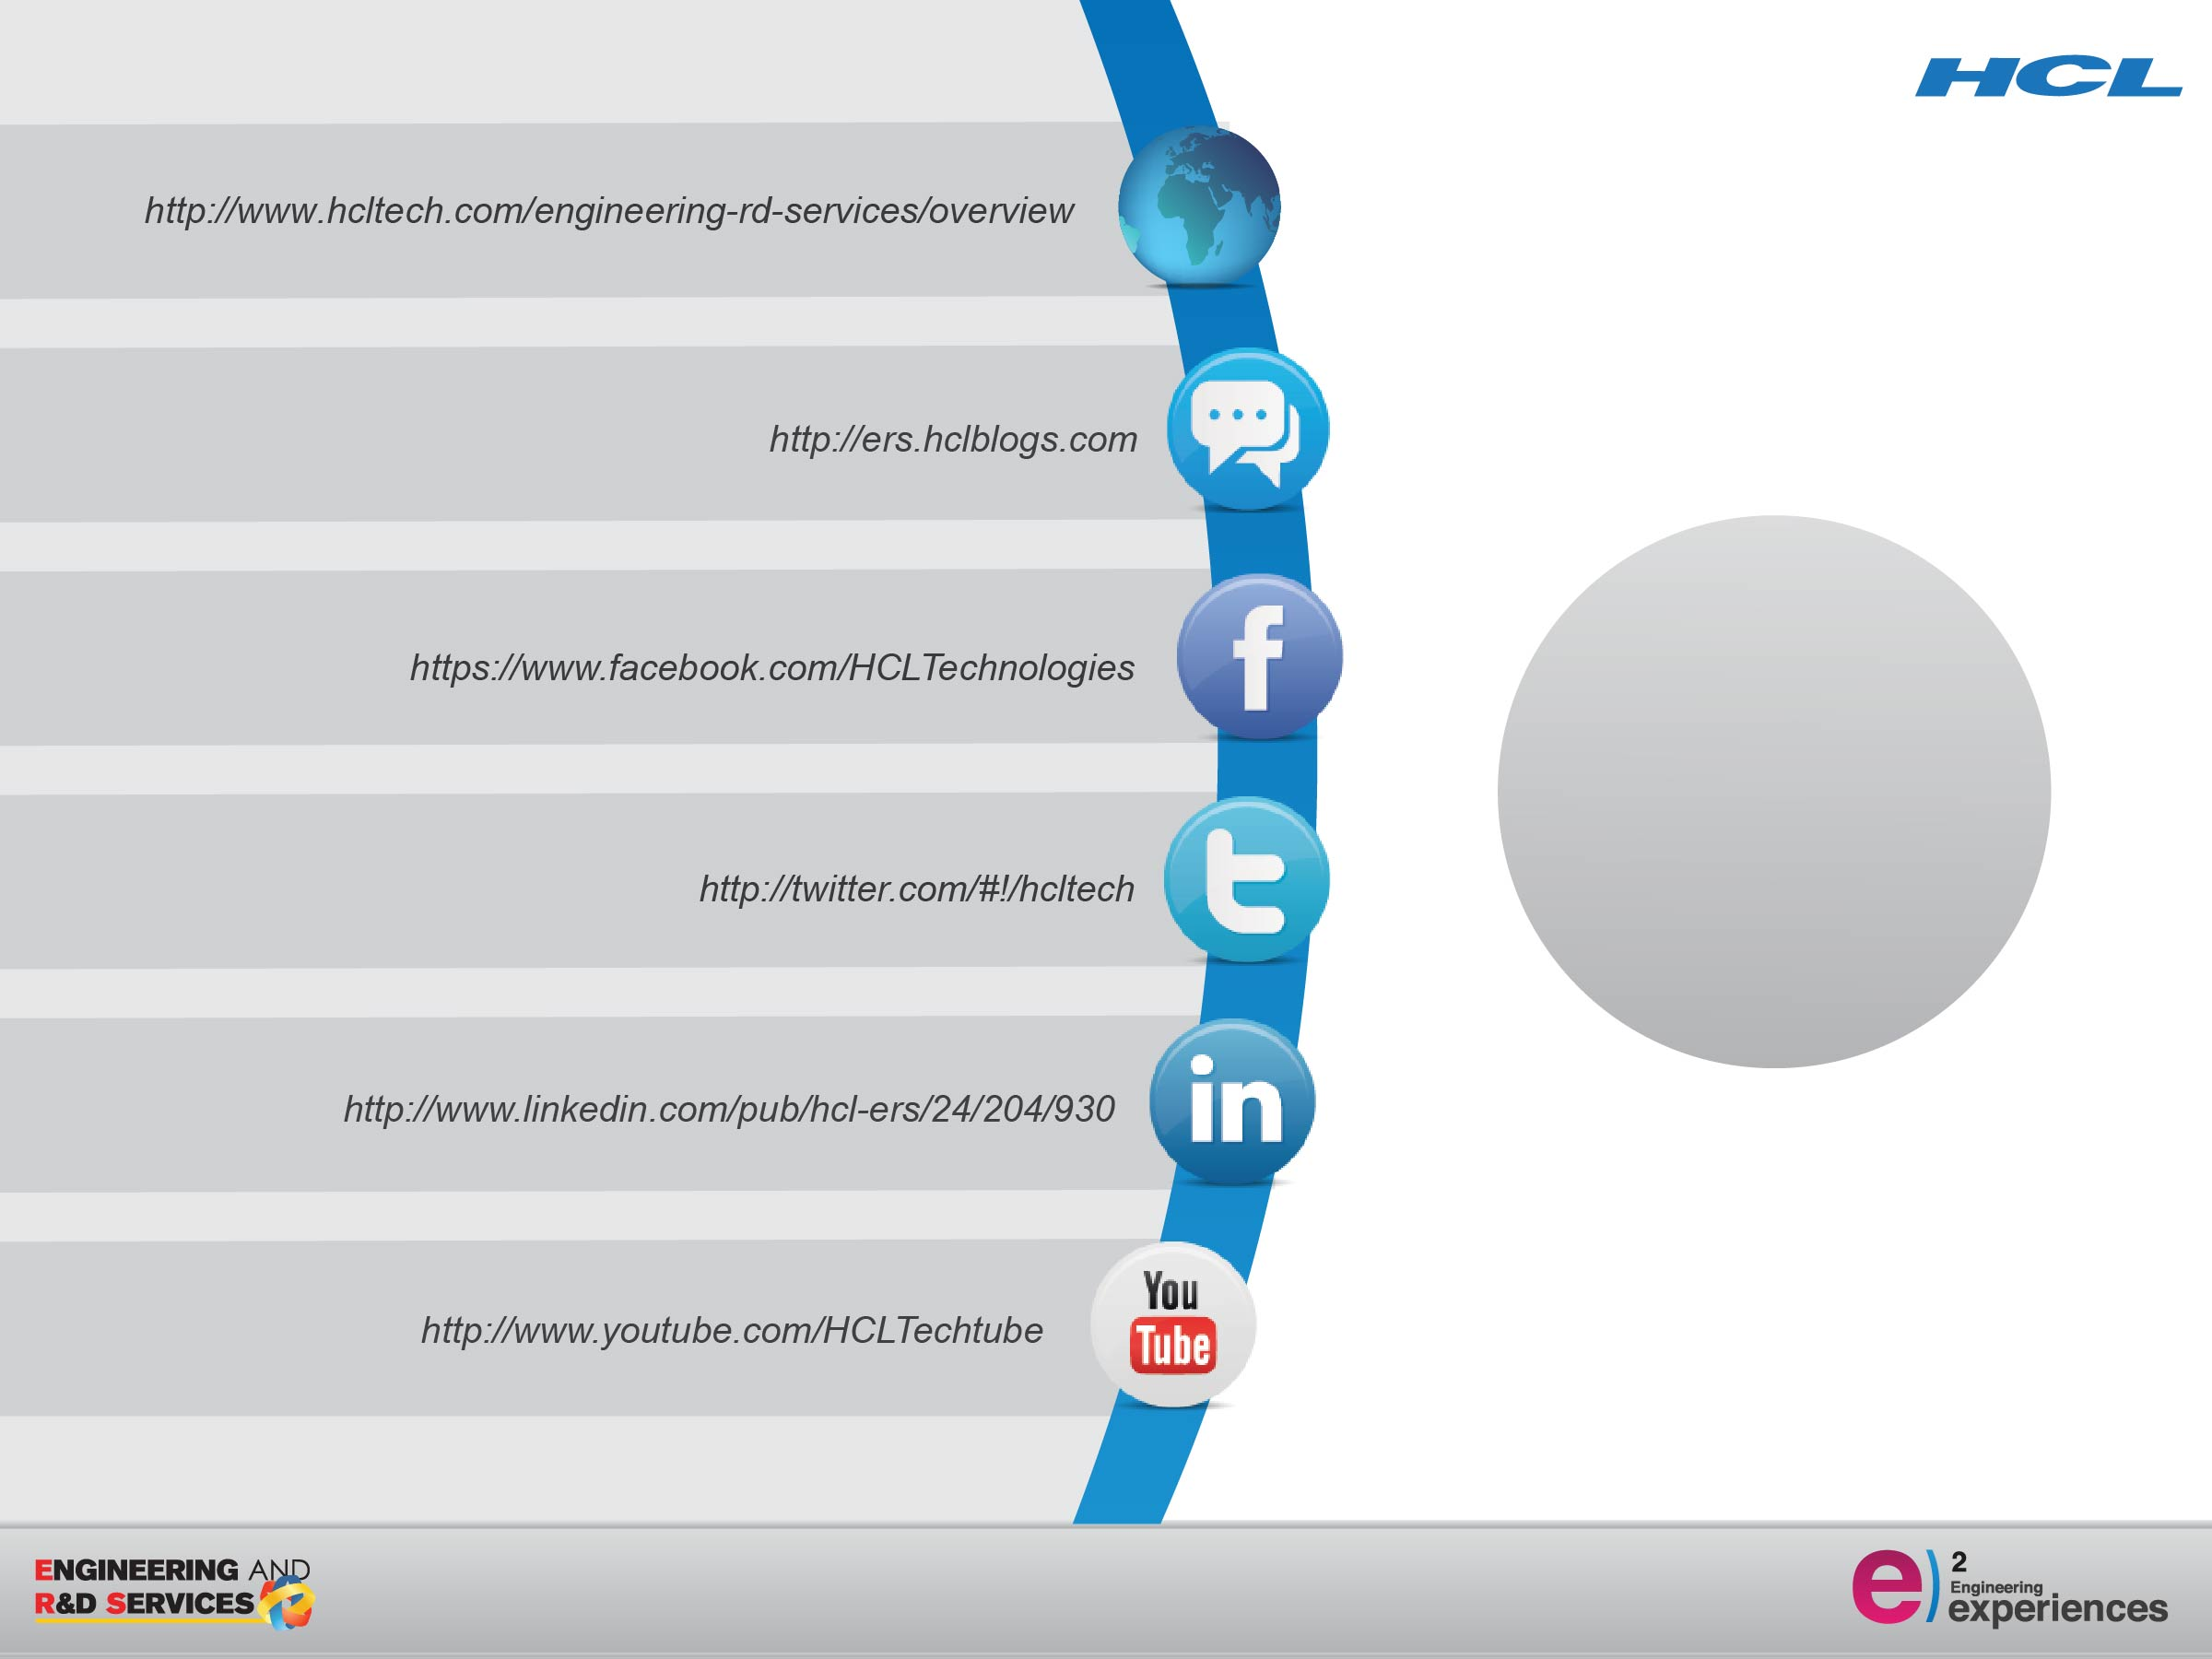
Thank You

